Slide 1

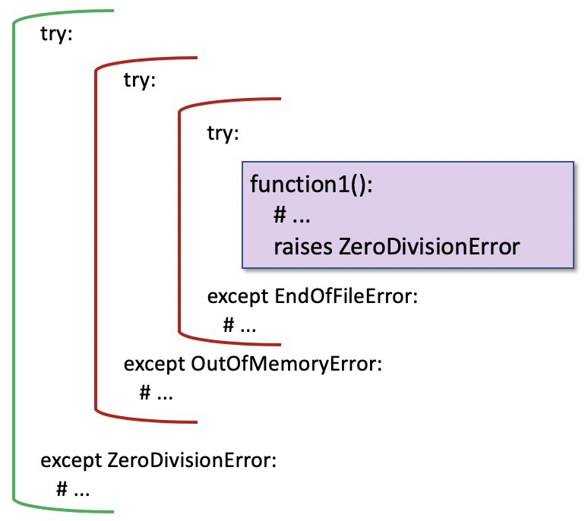
Error & Exception Handling
Kevin Cunningham

Slide 2

Plan for Session
Errors & Exceptions
Exception types in Python
Exception Handling
try-except blocks
default Exception Handler
else Clause
finally block
Raising an Exception / Error
Defining New Exceptions / Errors

Slide 3

Errors & Exceptions
Exceptions and Errors are objects in Python
Can occur in a variety of situations
File does not exist
Network connection fails
Import Error at runtime
Arithmetic Error (such as divide by zero)
Module load error
Want to be notified about these and take appropriate action

Slide 4
Exceptions Types in Python
Error and Exception types are classes
instantiated at runtime
creation is known as raising an error / exception
Root is the BaseException class
But all errors and exception extend Exception
No distinction in Python between errors & exceptions
Several subclasses of Exception
ArithmeticException - numeric errors
SyntaxError – raised when parser encounters syntax issue
RuntimeError – problem encountered at runtime

Slide 5
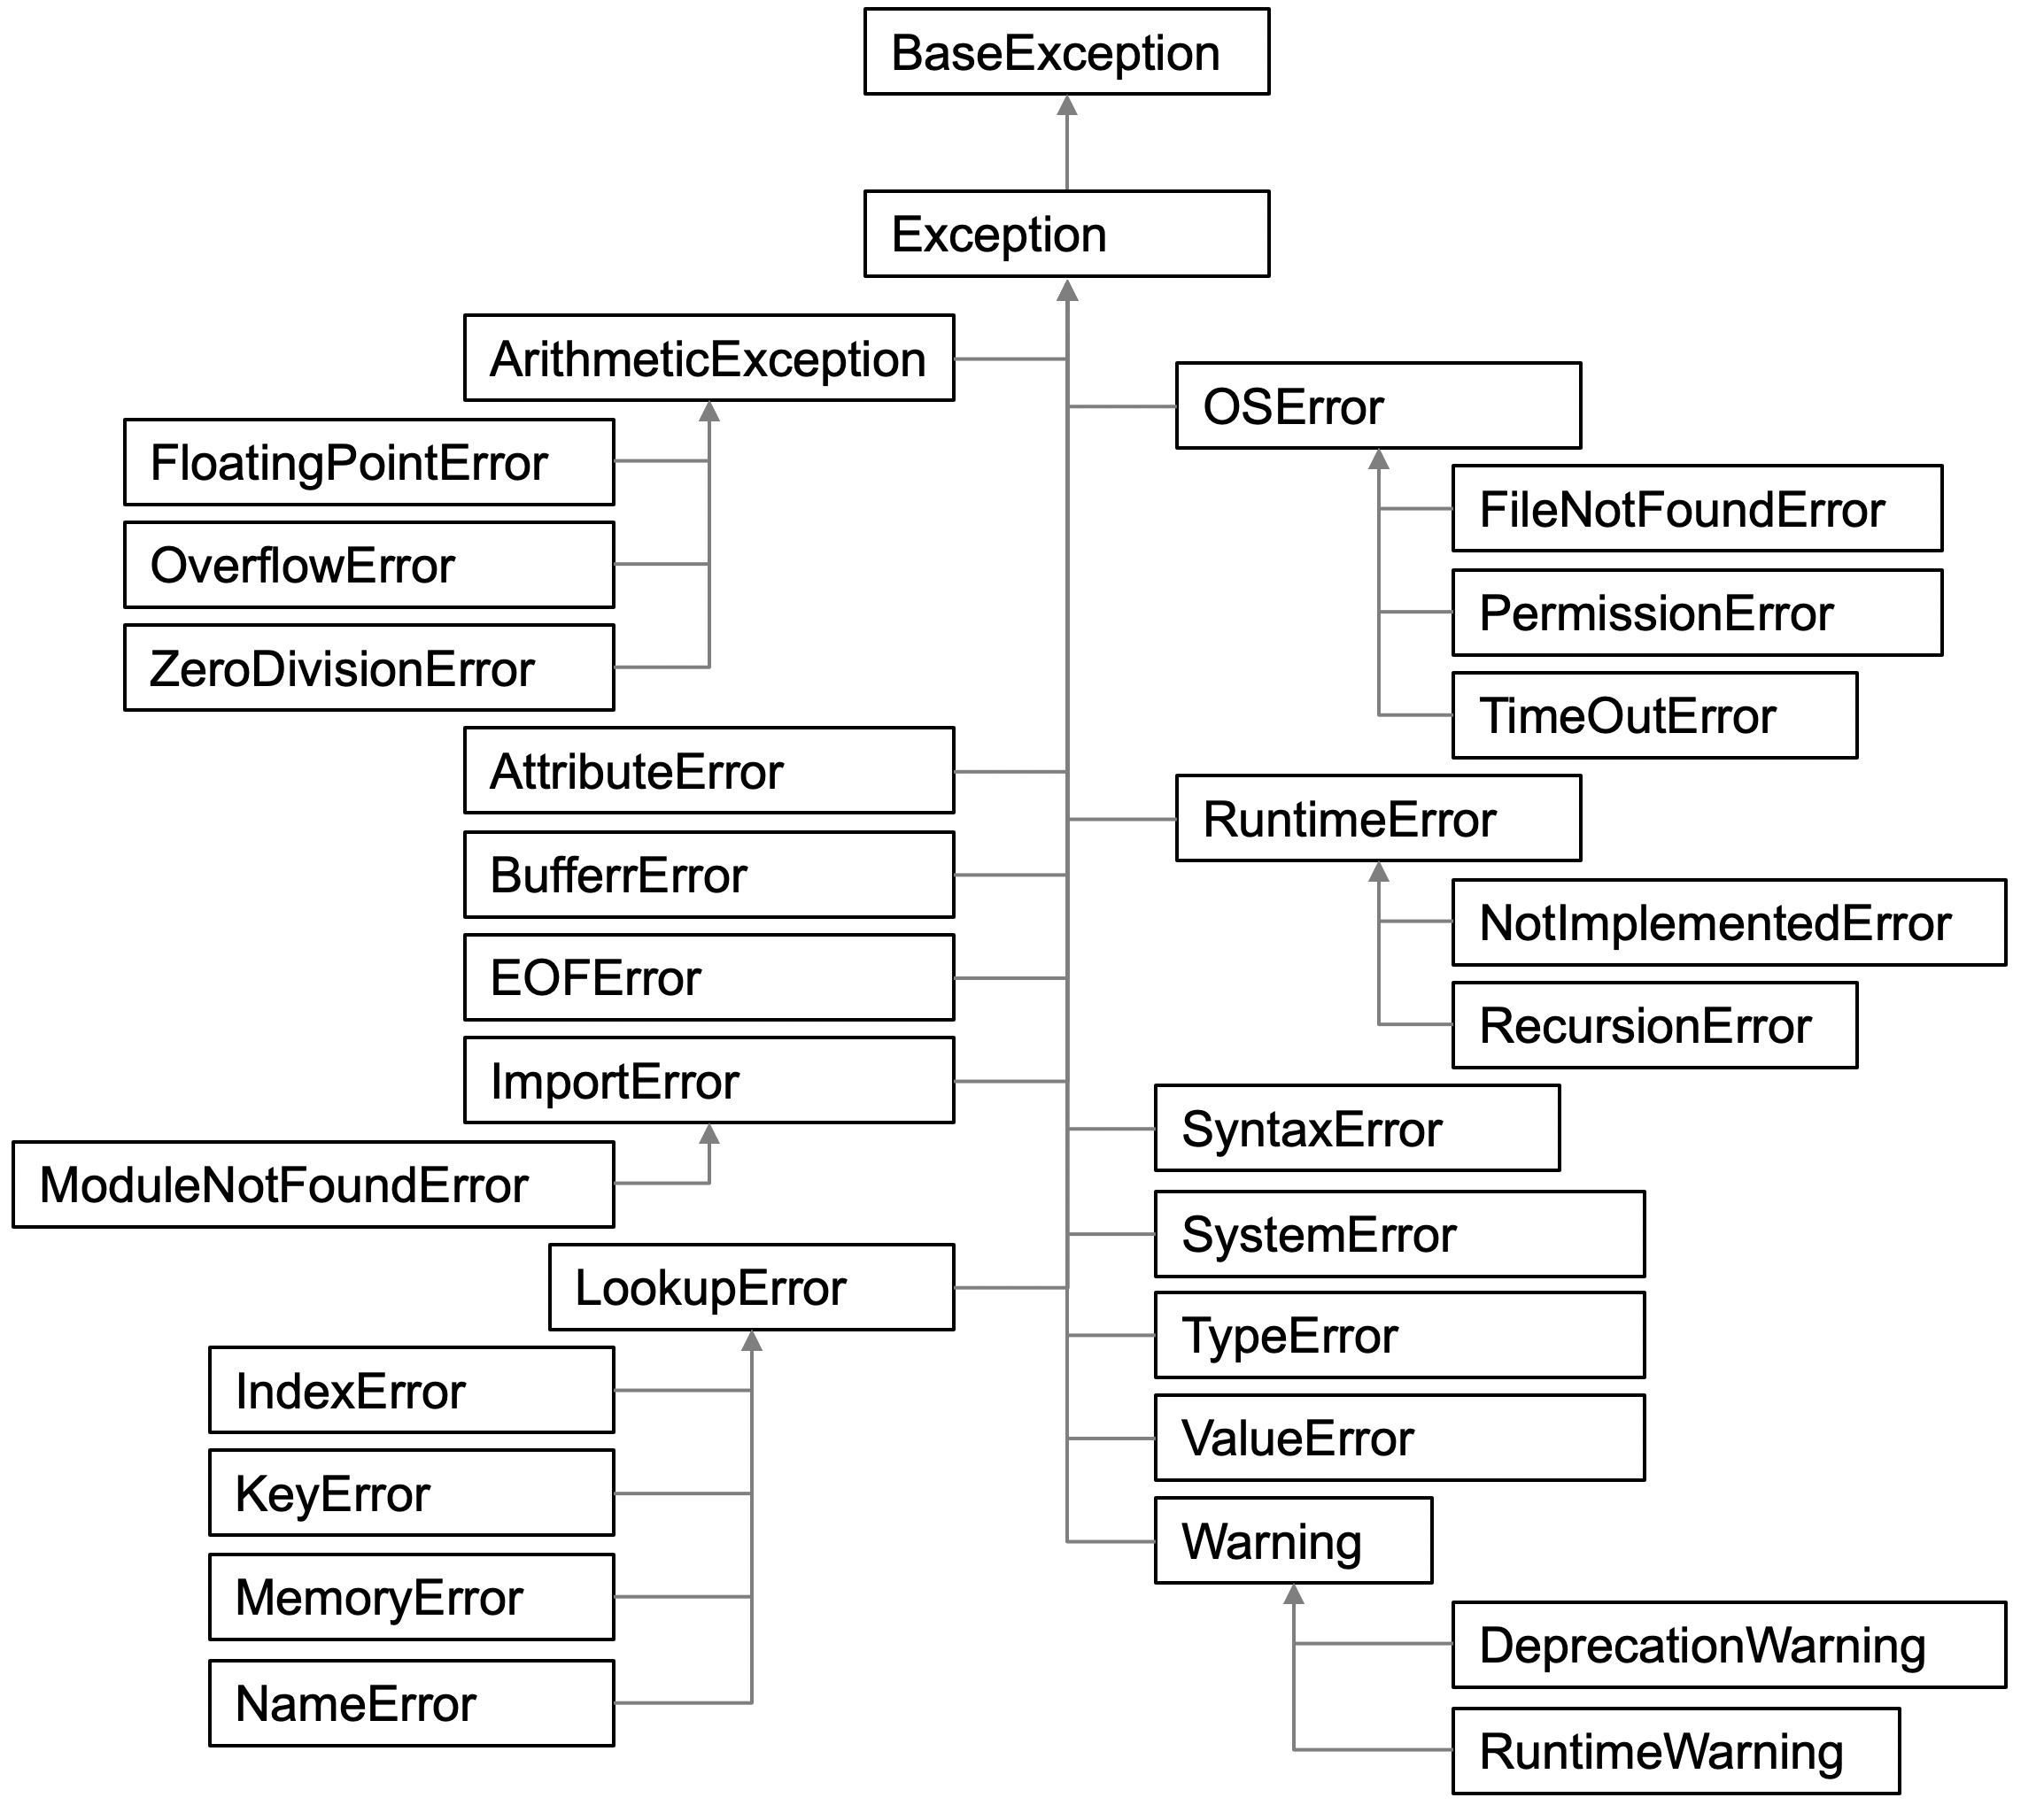
Part of the Exception Hierarchy

Slide 6

Exception Handling
Based on C++ / similar to Java
Exception raised by instantiating an exception class
Then thrown from where it is generated
And caught where it is handled
Exception handling blocks manage how exceptions handled
try: except: else: finally: blocks
raise statement
Notes:
Exceptions and Runtime
Can be handled by application code,
Bit like
If anything goes wrong in this code do this
Referred to as Exception Handling

Slide 7
Exception Handling Example
run_calculation function can raise the ZeroDivisionError
Enters try block
If all ok runs runcalc and jumps to line after print
If runcalc raises exception,
jump to except clause and
check to see if exception is a ZeroDivisionError (or subclass)
if it is run print statement
try: run_calculation(6) except ZeroDivisionError: print('oops')

Slide 8
Handling Multiple Exceptions
What if run_calculation can raise several different types of error or exception
If error / exception is raised, then
check for each type in turn starting with the first except
also checks for subclasses
try: run_calculation(6) except ZeroDivisionError: print('oops’)
except IndexError: print('arrgh') except FileNotFoundError: print('huh!') except Exception: print('Duh!’)

Slide 9
Accessing the Exception object
Possible to access exception object being caught
If multiple except clauses
can choose to access exception object or not
try: run_calculation(6) except ZeroDivisionError as exp: print(exp) print('oops')
division by zero
oops
try: run_calculation(6) except ZeroDivisionError as exp: print(exp) print('oops') except FileNotFoundError: print('huh!') except Exception as exception: print(exception) print('Duh!')

Slide 10
Else Clause
Can also have an optional else clause
If else clause is present,
then it must come after all except clauses
The else clause is executed
if and only if no exceptions were raised
if any exception was raised the else clause will not be run.
try: my_function(6, 2) except ZeroDivisionError as e: print(e) else: print('Everything worked OK')

Slide 11
Finally Clause
Optional finally clause
last clause in the statement
must come after any except clauses
as well as the else clause
Will always run whether an exception occurred or not
try: my_function(6, 0) except Exception:
print(‘In except’)
else: print('Everything worked OK') finally: print('Always runs')

Slide 12
Getting a Traceback
traceback module used to print stack traces
useful when need to print stack traces under program control
Import the module and then use traceback functions
import traceback
try: print(6 / 0) except Exception as exp: print('oops') print(exp) traceback.print_exc()
oops
division by zero
Traceback (most recent call last):
File "/traceback-example.py", line 4, in <module>
print(6 / 0)
ZeroDivisionError: division by zero

Slide 13
Nesting Exception Blocks
Can nest try: except: blocks
Inner most try-except blocks tried first
If not handled propagates outwards

Slide 14
Raising An Exception
An error or exception is raised using the keyword raise. The syntax of this is
raise <Exception/Error type to raise>()
For example:
Can also use shorthand form
raise ValueError
Can also re raise error /exception
def function_bang(): print('function_bang in') raise ValueError('Bang!') print('function_bang out')
try: function_bang() except ValueError as ve: print(ve)
function_bang in
Bang!

Slide 15
Defining New Exceptions / Errors
Create new exceptions by subclassing existing ones
use Exception or a subclass of Exception
do not use BaseException
Creates a new Exception class
could have supplied more data via _ _init_ _ method if required
Can use with method to set an age
class InvalidAgeException(Exception): """ Valid Ages must be between 0 and 120 """
def set_age(self, value):
print('In set_age method(', value, ')')
if isinstance(value, int) & (value > 0 & value < 120):
self._age = value
else:
raise InvalidAgeException()
Notes:
You should only create an exception when you need it, because Stack Trace and Line Number information added when exception is created.
Mention Performance Overhead of exception.

Slide 16
Questions?
?

